Slide 1
CUDA Advanced Libraries
CUDA Machine Learning

Slide 2
Neural Networks
“Neural networks reflect the behavior of the human brain, allowing computer programs to recognize patterns and solve common problems in the fields of AI, machine learning, and deep learning.” [1]
They have been around for a while in different forms with different names
They are used to solve numerous problems such as natural language processing, object recognition, etc.
They are computational expensive in general but work really well on GPUs

Slide 3
What makes a Neural Net
Requires input and output nodes
Includes a number of layers of internal nodes
Internal nodes are often hidden, meaning their computation is not explicitly available
Nodes can be binary, continuous or categorical
A node can use any computation, but often are rather simple, think comparing pixels in an input image to an known image
Nodes are connected from one layer to the next layer

Slide 4
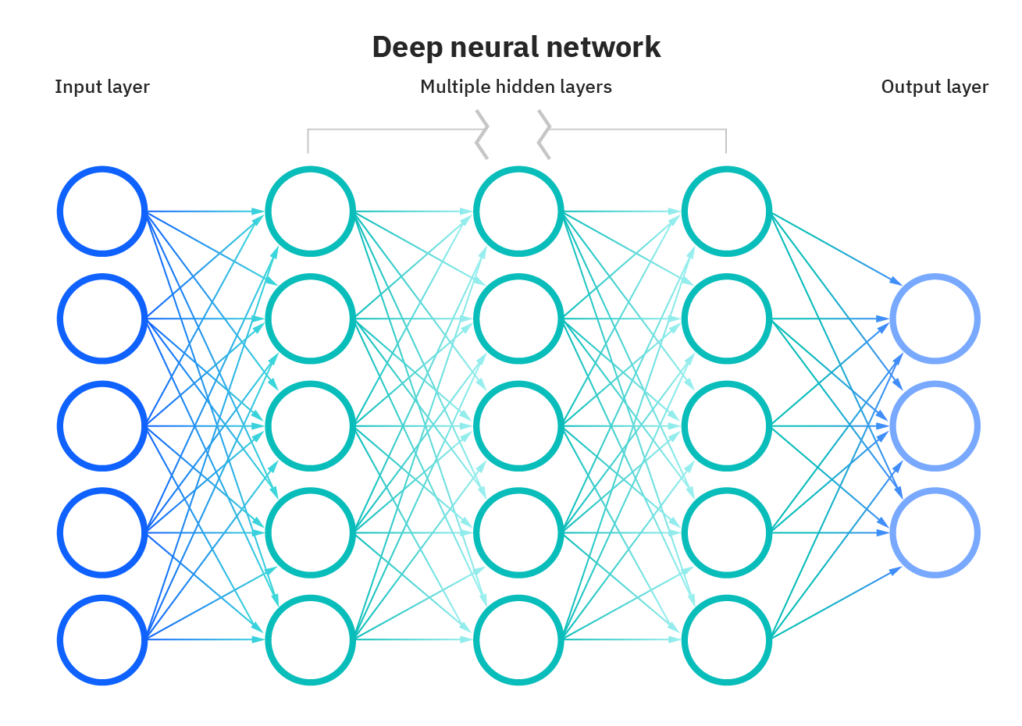
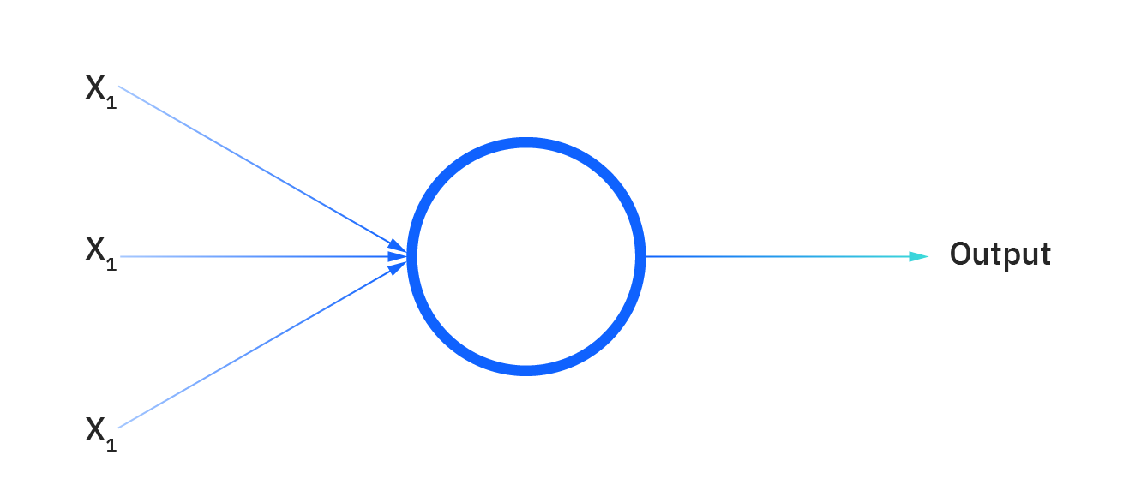
What do they look like conceptually?
[1]
Perceptrons are simple NNs, many inputs one output
There is a general correlation between numbers of layers and the amount learned and how well it does its job.

Slide 5
Where do GPUs come in?
Think of each node in a neural network as a processor on a GPU
Give each node an input and have it perform an operation that outputs either a 0 or 1, though it can be continuous
Each successive layer gets information from the previous layer (consider these blocks) until the output layer indicates something like a word in a language to output for a human to read
For this to work, you need to make calculations simple and independent…check!
Connect everything up and run…cuDNN

Slide 6
References
[1] 2020. IBM Cloud Education. Neural Networks. Found at https://www.ibm.com/cloud/learn/neural-networks.

